Slide 1
Bias-Variance and its Trade off

Slide 2
What is Bias
Bias is the difference between the average prediction of our model and the correct value which we are trying to predict
Model with high bias pays very little attention to the training data and oversimplifies the model.
It always leads to high error on training and test data.

Slide 3
What is Variance
Variance is the variability of model prediction for a given data point or a value which tells us spread of our data
Model with high variance pays a lot of attention to training data and does not generalize on the data which it hasn’t seen before.
Such models perform very well on training data but has high error rates on test data.

Slide 4


Math Behind It
Y=f(X) + e ; e is the error term
Irreducible error is the error that can’t be reduced by creating good models.

Slide 5
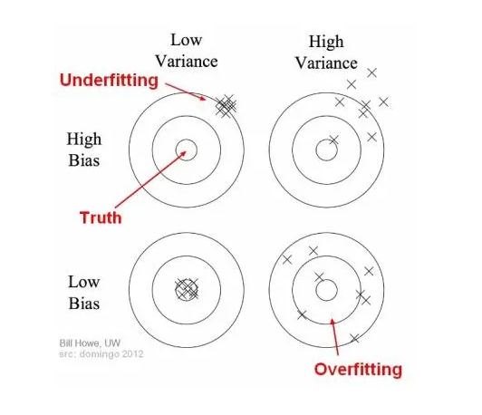
Bias and variance using bulls-eye diagram

Slide 6
Underfitting
In supervised learning, underfitting happens when a model unable to capture the underlying pattern of the data.
These models usually have high bias and low variance.
It happens when we have very less amount of data to build an accurate model or when we try to build a linear model with a nonlinear data

Slide 7
Overfitting
In supervised learning, overfitting happens when our model captures the noise along with the underlying pattern in data
It happens when we train our model a lot over noisy dataset
These models have low bias and high variance.

Slide 8
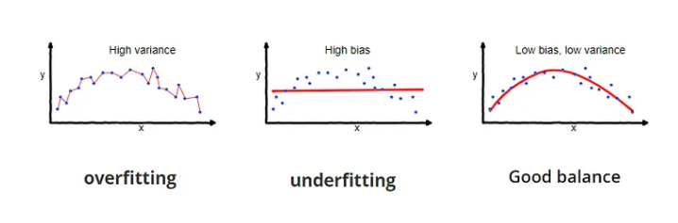
Diagram

Slide 9
Trade off
If our model is too simple and has very few parameters then it may have high bias and low variance.
On the other hand if our model has large number of parameters then it’s going to have high variance and low bias. So we need to find the right/good balance without overfitting and underfitting the data.
So there is trade off

Slide 10
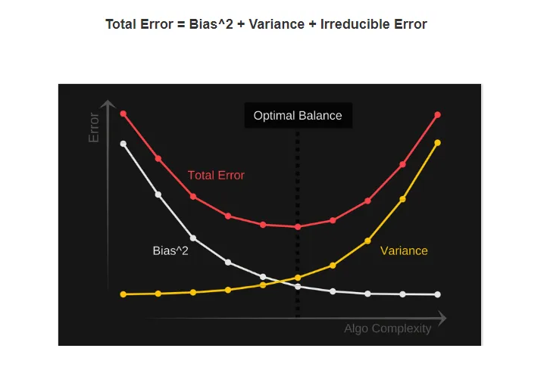
Trade off Visualization

